Slide 1
GEOMETRIC MODELLING · PUSAN NATIONAL UNIVERSITY
How a 3D Model Becomes a Puzzle
Take any 3D model. Cut it into a handful of solid pieces that can each be 3D-printed and then fitted back together.
This is how the program decides where to cut.

Slide 2
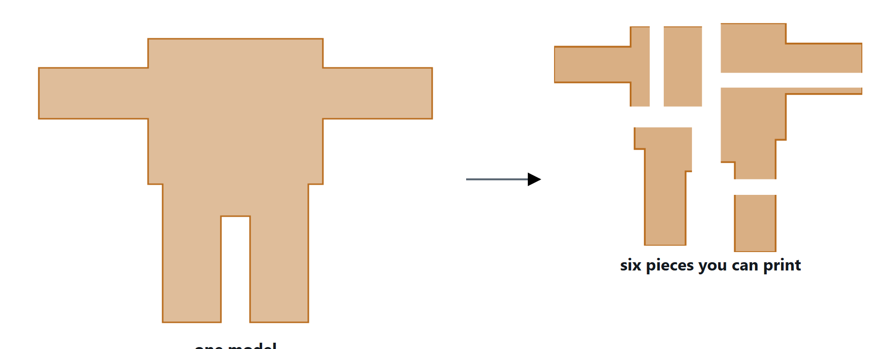
THE GOAL
One model in, several printable pieces out
Not slices, and not a grid of identical blocks. Pieces of different shapes that only go back together one way — a puzzle.
2

Slide 3
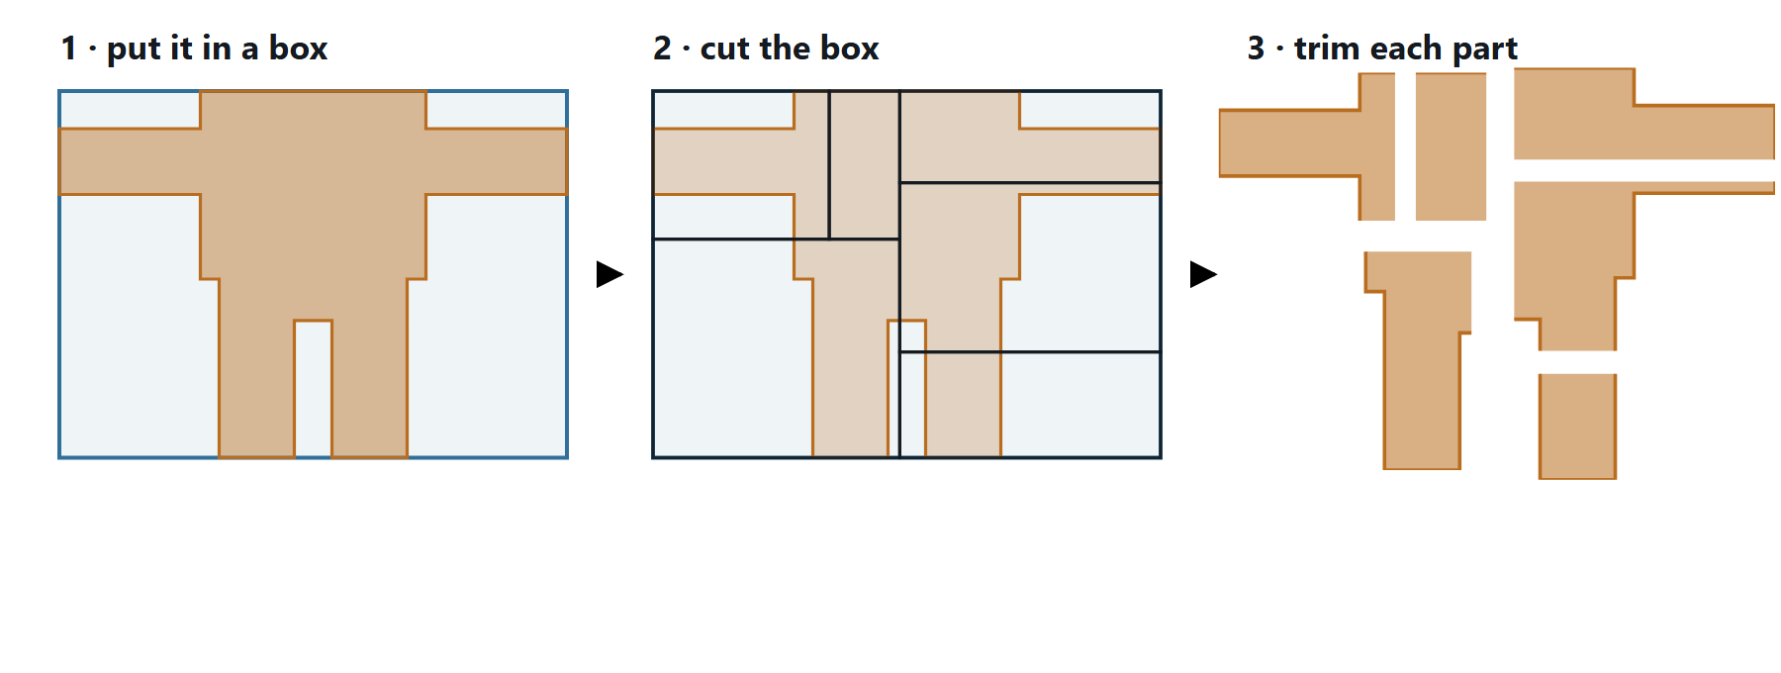
THE TRICK
Cut a simple box, then trim it to the model
Cutting a complicated shape directly is hard. So the program puts the model inside a plain box, cuts the box into parts, and then trims each part back to the model.
The pieces end up with the model’s real surface.
3

Slide 4
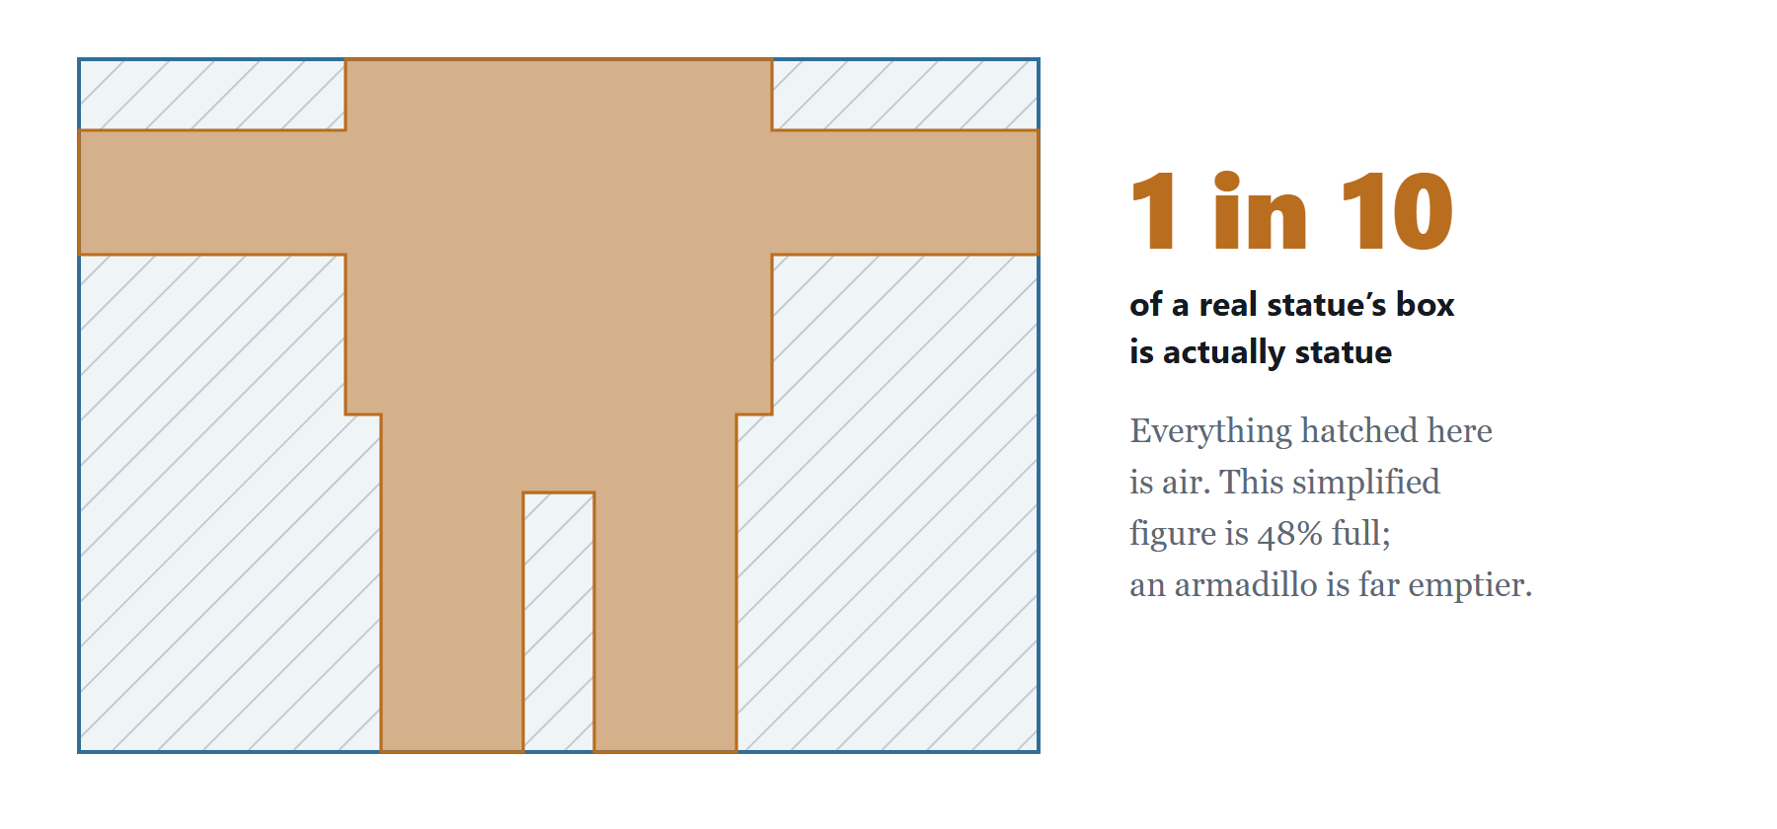
THE PROBLEM
A box around a model is mostly empty
Between the arms, between the legs, around every curve — most of the box is air, and the program cutting it up cannot see the model at all.
4

Slide 5
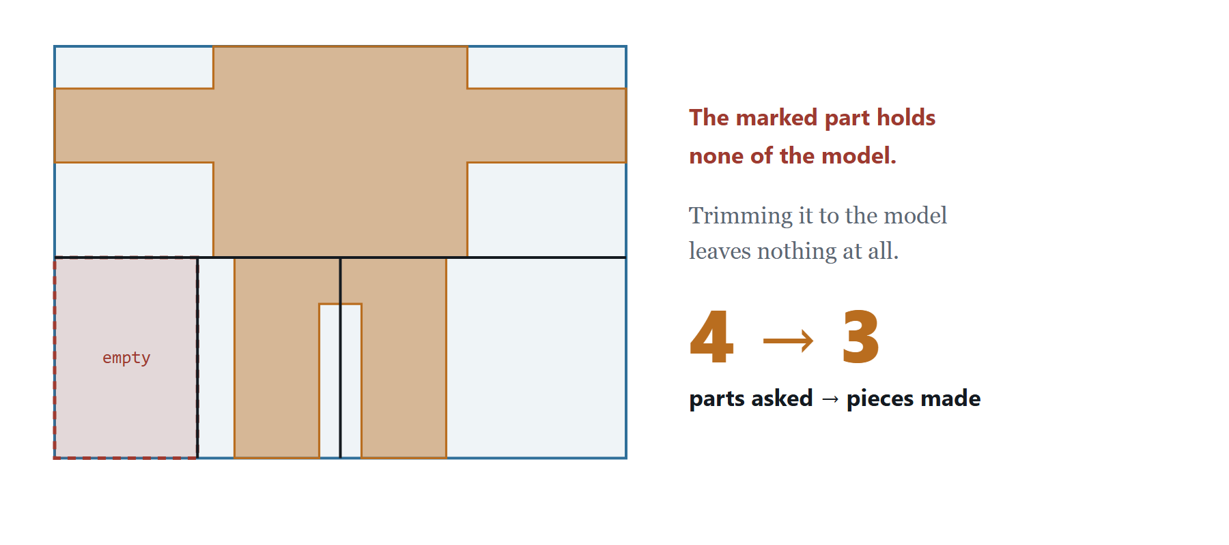
WHAT GOES WRONG
Cut the box evenly and you lose a piece
Halve the box, then halve it again, and sooner or later one of the parts lands where there is nothing. Trim it to the model and it yields nothing at all.
Here four parts give three pieces; on a real statue, six gave five.
5

Slide 6
THE FIX
Stop cutting the box evenly.
Cut where the model actually is.
Everything that follows is how a program does that when it cannot simply look at the shape the way you can.

Slide 7
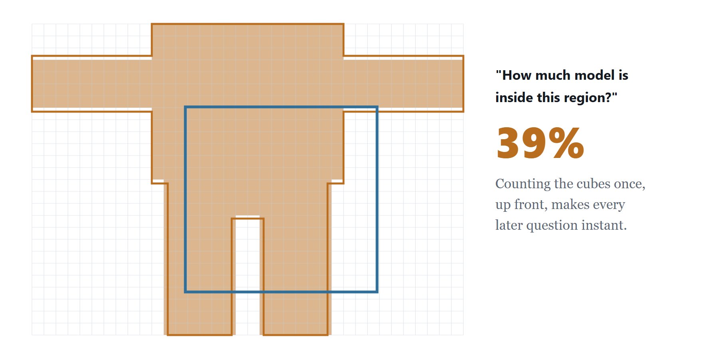
STEP 1 · MEASURE
Fill the model with cubes and count them
Once, at the start, the model is filled with small cubes. After that the program can ask “how much model is inside this region?” and get an answer immediately — no matter how often it asks.
7

Slide 8
STEP 2 · CHOOSE
Always cut the part holding the most model
Each round, the program looks at the parts it has so far and picks the one containing the most material — never a random one.
This is what keeps the pieces comparable. Choosing at random once left a single piece holding 80% of the whole model, because the big part simply never came up again.
8

Slide 9
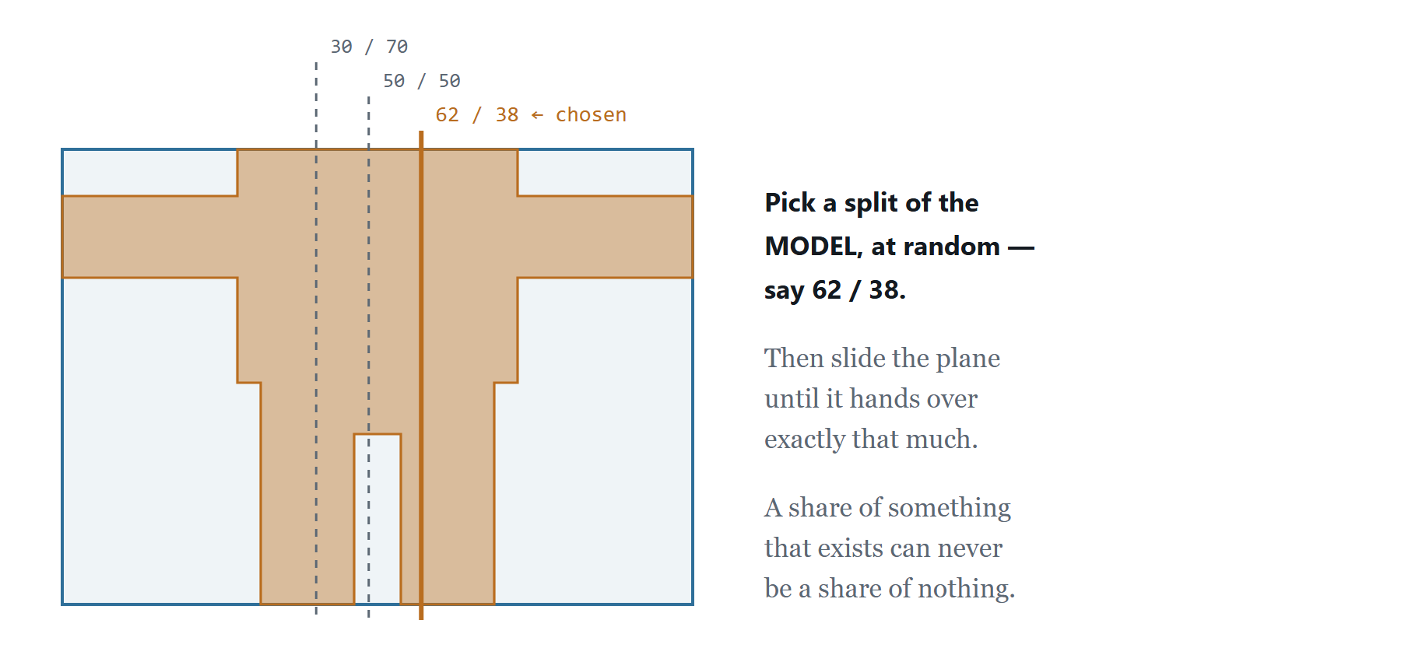
STEP 3 · PLACE THE CUT
Aim for a share of the model, not a position
Rather than cutting at some position and seeing what happens, the program first decides how to divide the material — 62 / 38, say — and then slides the plane until it hands over exactly that much.
9

Slide 10
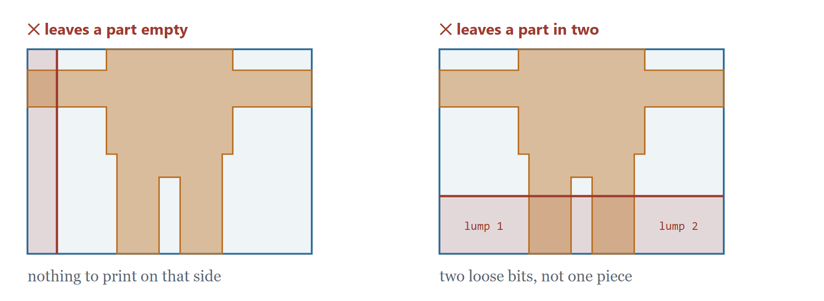
STEP 4 · CHECK
Two cuts the program always refuses
A cut can hand over the right amount and still be a bad cut. Both of these are rejected, and a different direction is tried instead.
10

Slide 11
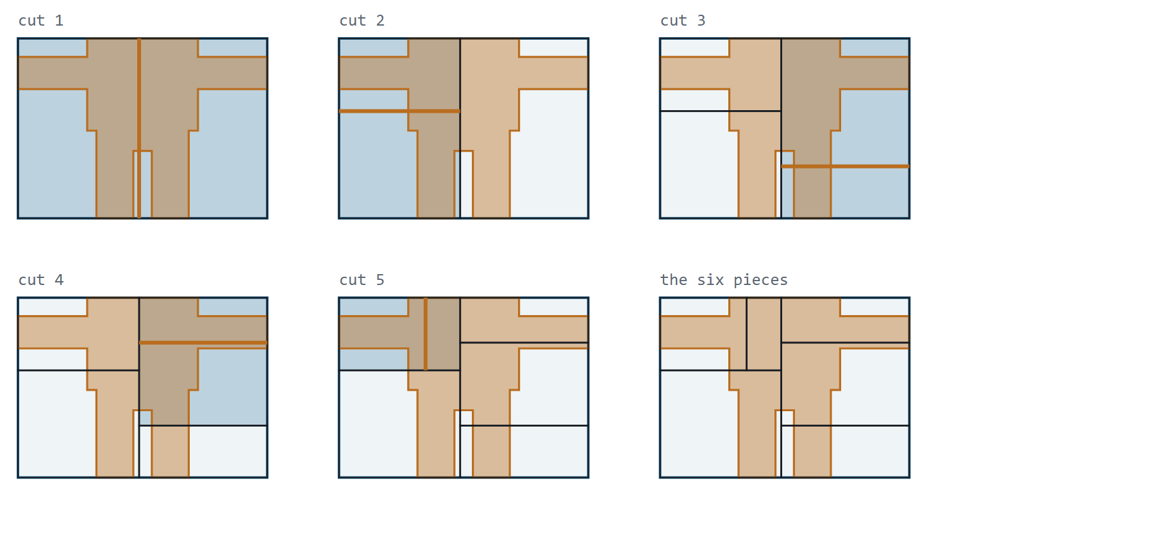
PUTTING IT TOGETHER
Five cuts, six pieces
The shaded part is the one chosen that round — always the fullest — and the orange line is where the cut landed.
11

Slide 12
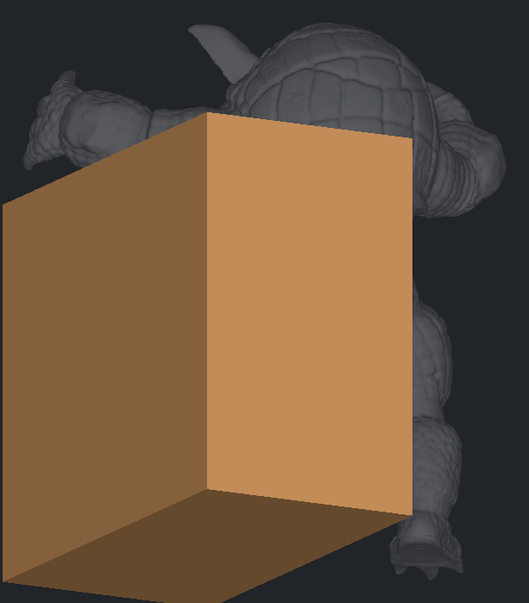
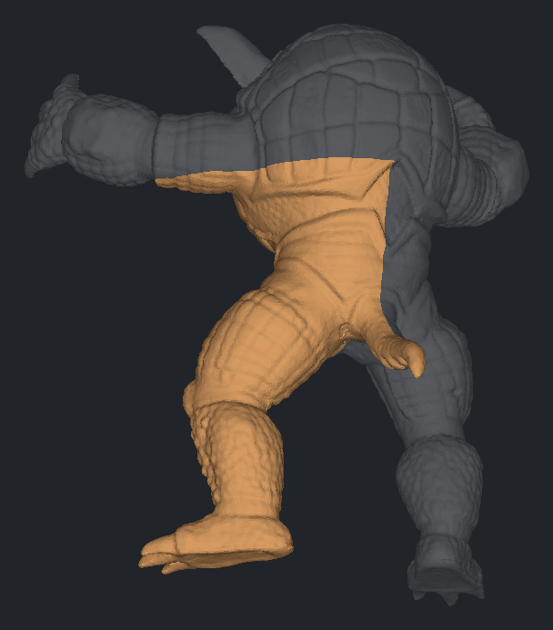
THE LAST STEP
The box never has to fit the model
Up to here every part is still a plain box. The detail arrives in one operation at the end: keep only what the box and the model both occupy.
Before — one part, still a box
After — kept only where the model is
The outside is the model’s real surface; the flat faces are the box’s — the cuts that let the pieces fit back together.
12

Slide 13
THE RESULT
What changed, measured on a real model
A statue of an armadillo — arms, legs, a tail, and a great deal of air around them. Ask for six pieces:
6 of 6
pieces returned, where the old
method returned five
100%
of the model ends up in the
pieces — nothing lost
2.8×
between largest and smallest
piece, down from 175×
0
pieces that fall apart into
loose bits
13

Slide 14
IN ONE SLIDE
The whole idea
01
Box it
Put the model in a plain box, because a box is easy to cut.
02
Measure it
Fill the model with cubes, so the program can tell where the material is.
03
Cut the fullest part
Every round, split whichever part holds the most model.
04
Split the material, not the space
Choose how much model goes each way, then find the plane that does it.
05
Refuse bad cuts
Never leave a part empty, never leave one in two loose bits.
06
Trim to the model
Each part is cut back to the real surface — and those are the pieces.
14

Slide 15
APPENDIX
How many cubes, exactly?
The resolution is fixed, not the count: 96 cubes along the model’s longest side, with the other two axes scaled so the cubes stay cubic. The total therefore depends on the shape of the bounding box.
Model | Grid | Cubes | Inside the model | Cube side
armadillo | 81 × 96 × 73 | 567,648 | 60,837 (10.7%) | 1.57
sphere | 96 × 96 × 96 | 884,736 | 453,528 (51.3%) | 0.42
cow | 53 × 94 × 96 | 478,272 | 122,983 (25.7%) | 0.018
The cubes never touch the pieces. They only decide WHERE the cuts go; each piece is then computed by an exact intersection with the original model, so the resolution affects cut placement by at most one cube and never the accuracy of a piece.
15

